Slide 1
Examining differential gene expression in alcohol preferring and non-alcohol preferring rats
Ethan O’Keefe

Slide 2
Rats
Propensity to Consume Alcohol¹
Limited in most rats (brown rat)
Requires significant positive associations / fading procedures.
Wistar and p-rats
Bred with a higher propensity to consume
My work at UNH
Behavioral neuroscience
Identifying endophenotypes of individuals vulnerable to alcohol abuse

Slide 3







Project overview
Gather Sequences
Assemble Wistar Sequence
Analysis
2
Notes:
Mention you got the reference genome from ncbi as well

Slide 4
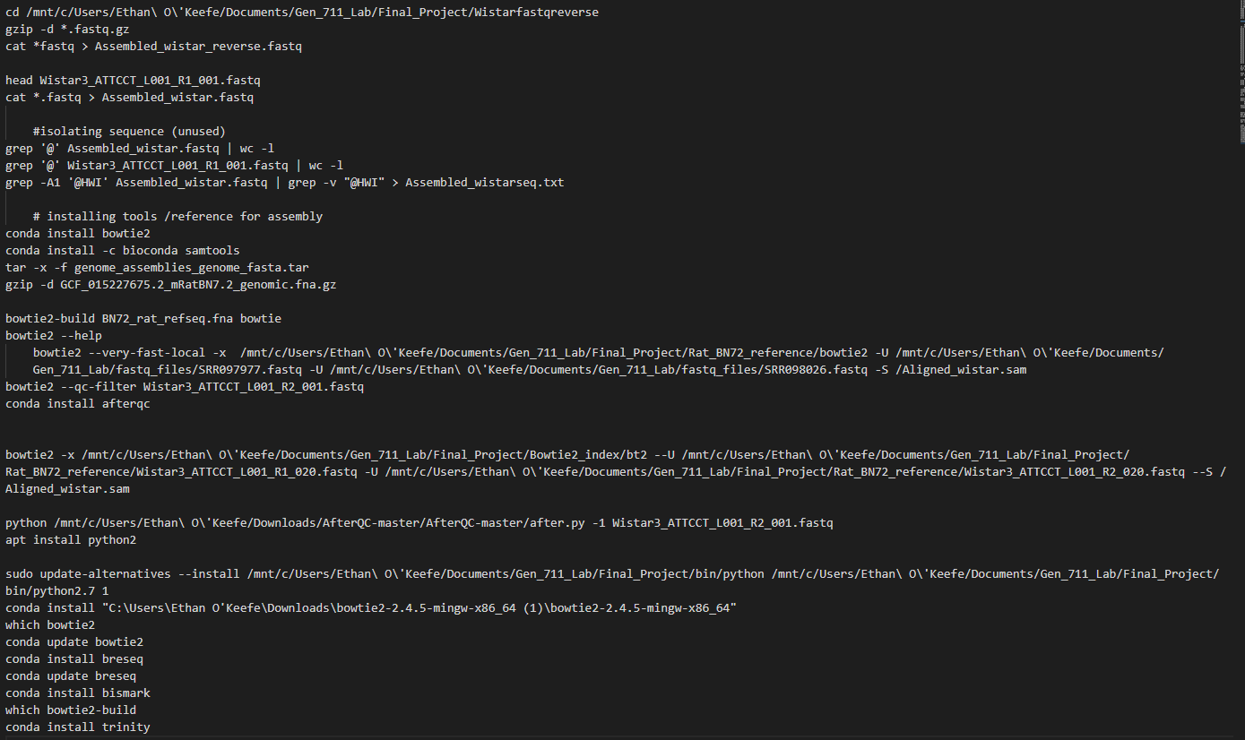


Roadblocks
3

Slide 5
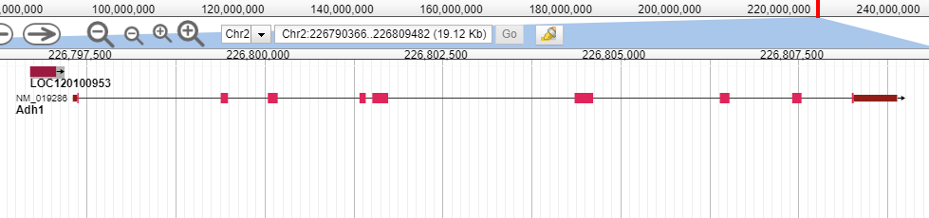
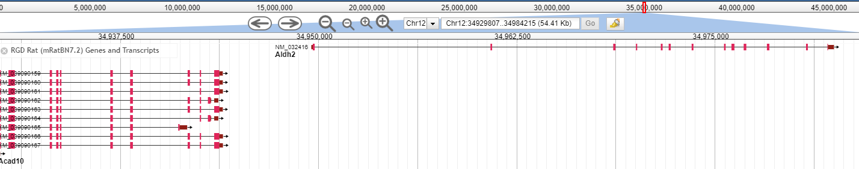
Analysis
Genes of interest (AUD)^{4,5}
Aldh2
ADH1B,C
FTO
SLC39A8

Slide 6
Works Cited
Vengeliene, Valentina. “A Comparative Study on Alcohol-Preferring Rat Lines: Effects of Deprivation and Stress Phases on Voluntary Alcohol Intake.” Alcoholism, Clinical and Experimental Research, U.S. National Library of Medicine, https://pubmed.ncbi.nlm.nih.gov/12878910/.
“Study Reveals Genes Associated with Heavy Drinking and Alcoholism.” ScienceDaily, ScienceDaily, 2 Apr. 2019, https://www.sciencedaily.com/releases/2019/04/190402124314.htm.
Liu, Tiancheng, et al. “Comparative Genome of GK and Wistar Rats Reveals Genetic Basis of Type 2 Diabetes.” PloS One, Public Library of Science, 3 Nov. 2015, https://www.ncbi.nlm.nih.gov/pmc/articles/PMC4631338/.
“GREP - GNU Project - Free Software Foundation.” [A GNU Head] , https://www.gnu.org/software/grep/.
Edenberg, Howard J, and Tatiana Foroud. “Genetics and Alcoholism.” Nature Reviews. Gastroenterology & Hepatology, U.S. National Library of Medicine, Aug. 2013, https://www.ncbi.nlm.nih.gov/pmc/articles/PMC4056340/.
“Study Reveals Genes Associated with Heavy Drinking and Alcoholism.” ScienceDaily, ScienceDaily, 2 Apr. 2019, https://www.sciencedaily.com/releases/2019/04/190402124314.htm.
Fang, Zhide, et al. “Statistical Methods for Identifying Differentially Expressed Genes in RNA-Seq Experiments - Cell & Bioscience.” BioMed Central, BioMed Central, 31 July 2012, https://cellandbioscience.biomedcentral.com/articles/10.1186/2045-3701-2-26.

